Slide 1
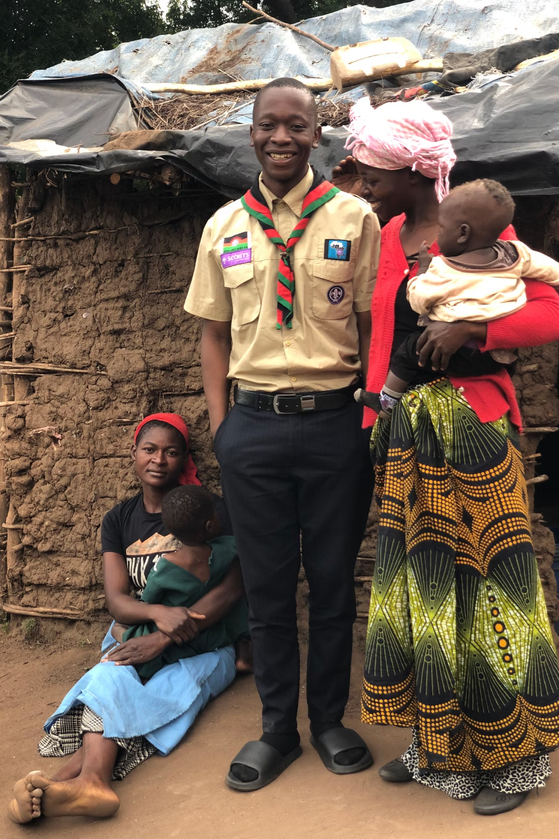
CleanGuard Hygiene Patrols
A youth-led movement for dignity, health, and hope
By Joseph Peter Kamvabingu, Troop Leader – CHAMBO Scout Troop Malawi

Slide 2

The Scout Promise Lives Here
"A Scout is clean in body, mind, and community. Today, we rise not just as individuals, but as a united force for dignity, health, and hope."
This mission embodies the very essence of Scouting: service to others, leadership through action, and building stronger communities one life at a time.

Slide 3



More Than Soap and Water
Restoring Pride
Preventing Disease
Proving Leadership
Empowering communities with dignity through proper hygiene practices and education
Stopping illness before it starts through proven hygiene and sanitation methods
Demonstrating that Scouts are always prepared to serve and lead positive change

Slide 4
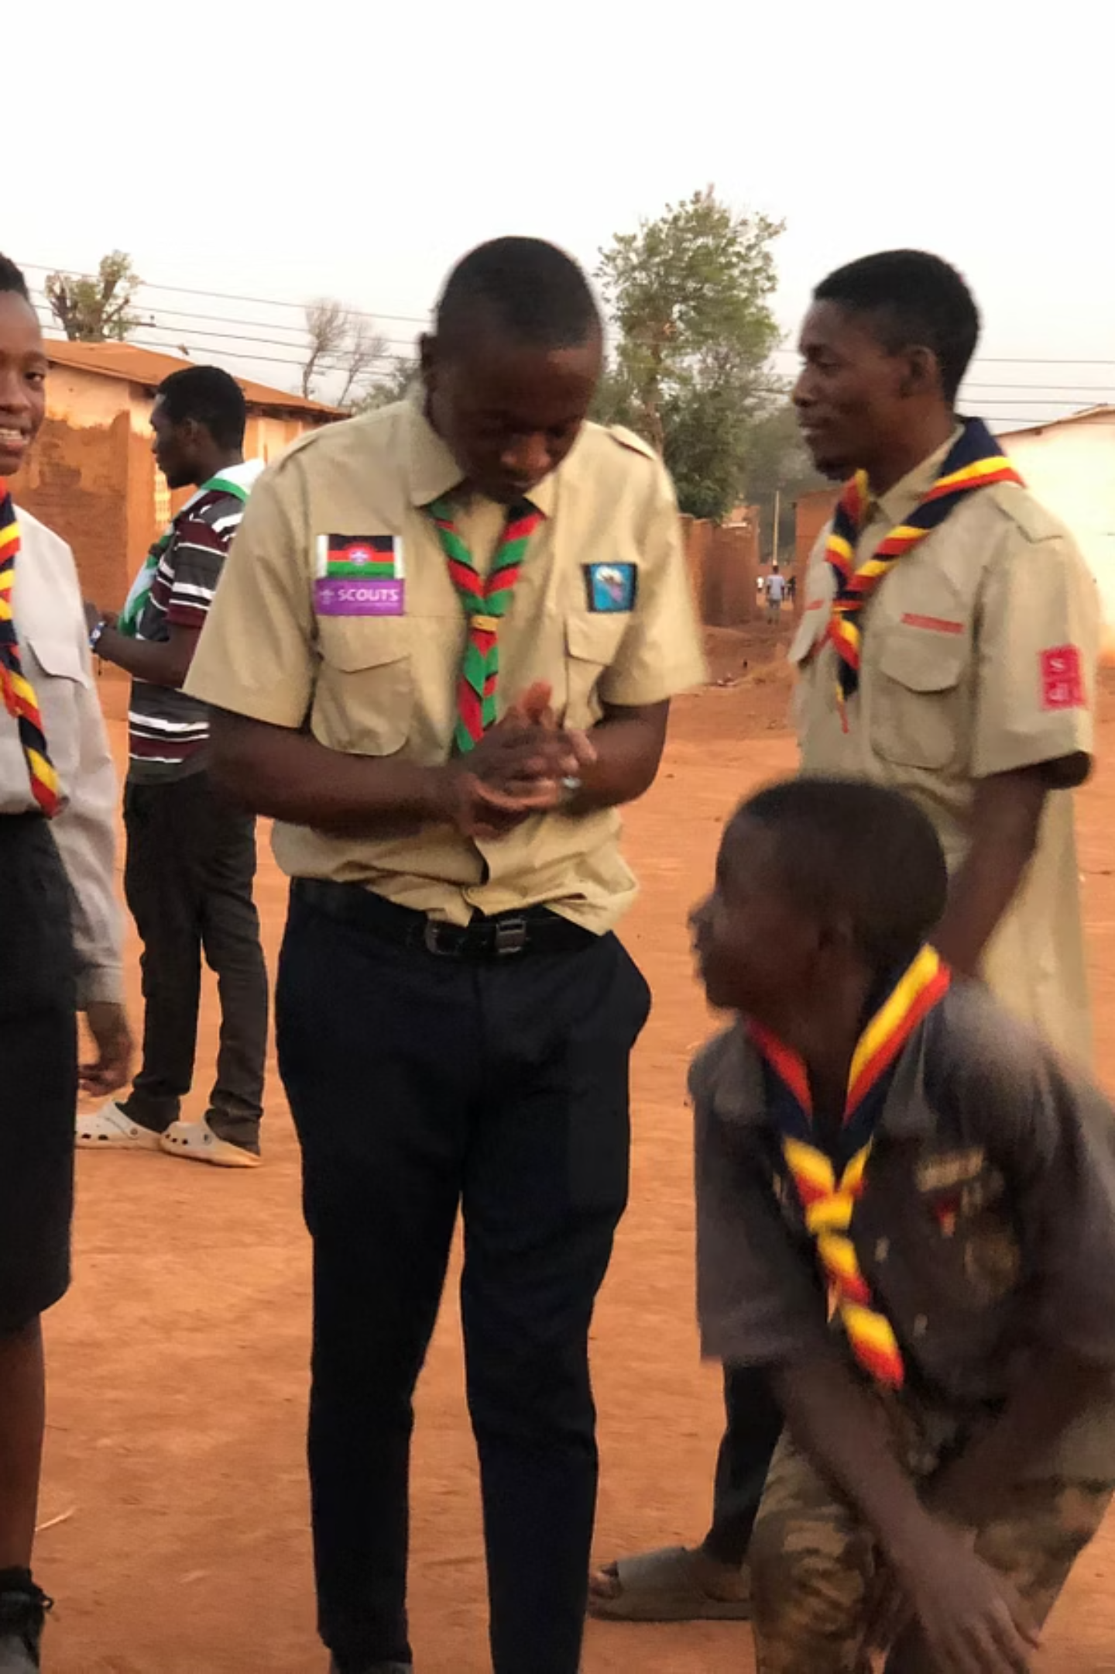
Meet Our CleanGuard Ambassadors
These specially trained Scout leaders will spearhead hygiene patrols across Malawi, bringing education and supplies directly to schools, markets, and villages where they're needed most.
Each Ambassador receives comprehensive training in hygiene education, community outreach, and leadership skills to maximize their impact.

Slide 5
Our Four-Point Action Plan
01
02
Train CleanGuard Ambassadors
Distribute Hygiene Kits
Develop Scout leaders to lead hygiene patrols in schools, markets, and villages throughout Malawi
Provide essential supplies while teaching handwashing, menstrual health, and water safety practices
03
04
Leverage Digital Innovation
Award CleanGuard Badges
Use mobile technology to track impact, share success stories, and inspire national action
Recognize Scouts who complete service missions and successfully mentor other community members

Slide 6

Essential Hygiene Kit Contents
Each Kit Includes:
Antibacterial soap bars
Hand sanitizer bottles
Toothbrushes and toothpaste
Menstrual hygiene products
Water purification tablets
Educational materials in local languages
Every kit represents hope, health, and the power of community care delivered directly by our Scout volunteers.

Slide 7




Technology for Maximum Impact
Track Progress
Monitor hygiene patrol visits, kit distributions, and community health improvements
Share Stories
Document success stories and community transformations to inspire continued action
Scale Nationwide
Use data insights to expand successful programs across all regions of Malawi

Slide 8
The CHAMBO Spirit in Action
Bold Leadership
Visible Impact
Service-Rooted
Taking decisive action where others hesitate, leading by example in every community we serve
Creating tangible, measurable change that communities can see, feel, and celebrate together
Grounding every action in genuine service to others, putting community needs above personal recognition

Slide 9

Making Hygiene Heroic
"This is a call to every Scout in Malawi and beyond join us in making hygiene heroic."
CleanGuard Hygiene Patrols transform everyday hygiene practices into acts of heroism, proving that the smallest actions can create the greatest change.

Slide 10
Together We Lead
Together, We Clean
Together, We Guard
Together, We Lead
Building healthier communities through shared commitment to hygiene and sanitation
Protecting our neighbors' health and dignity through vigilant care and education
Inspiring national transformation through the courage to act and serve others
Join the CleanGuard movement. The future of Malawi begins with us.

